Slide 1
Advanced Bean Configuration

Slide 2
Advanced Bean Configuration
BeanPostProcessor
FactoryBean
SpEL
Proxies
Profiles

Slide 3
Bean Lifecycle
Instantiation
Populate Properties BeanNameAware BeanFactoryAware
Pre Initialization - BeanPostProcessors InitializeBean
initMethod
Post Initialization - BeanPostProcessors

Slide 4





FactoryBean
Builds on initMethod concept
Factory Method Pattern
Legacy Code
Contract without Constructor
Static Methods

Slide 5
@Value("#{ T(java.lang.Math).random() * 100.0 }") private double seedNum;
SpEL
Manipulate Object Graph Evaluate at Runtime Configuration

Slide 6
Spring AOP Proxies
ProxyFactory factory = new ProxyFactory(new SimplePojo()); factory.adddInterface(Pojo.class);
factory.addAdvice(new RetryAdvice()); factory.setExposeProxy(true);
Pojo pojo = (Pojo) factory.getProxy();
// this is a method call on the proxy!
pojo.foo();
Spring Utilizes Proxies
When?
@Transactional

Slide 7
@Repository("speakerRepository") @Profile("dev")
public class HibernateSpeakerRepositoryImpl implements SpeakerRepository
Bean Profiles
Adapt Environments Runtime Configuration

Slide 14
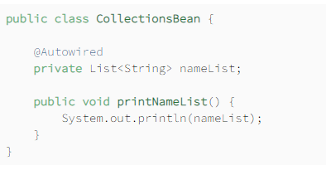
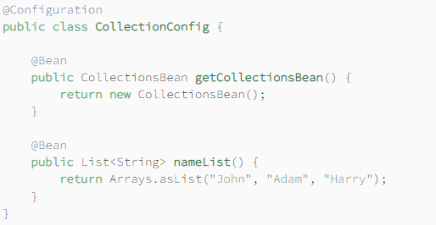
List With @Autowired

Slide 15
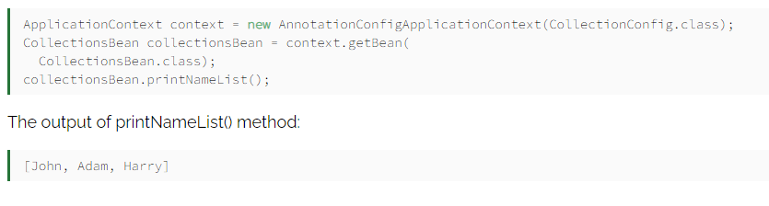

Slide 16
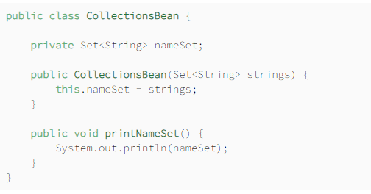
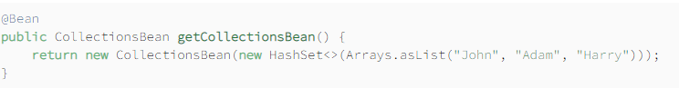
Set With Constructor Injection

Slide 17
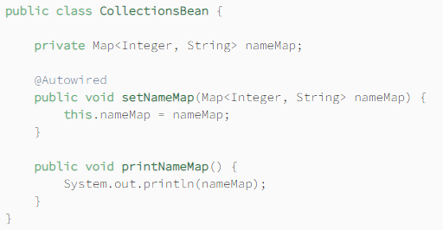
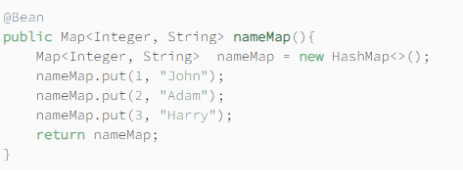
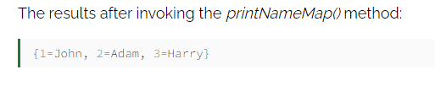
Map With Setter Injection

Slide 18
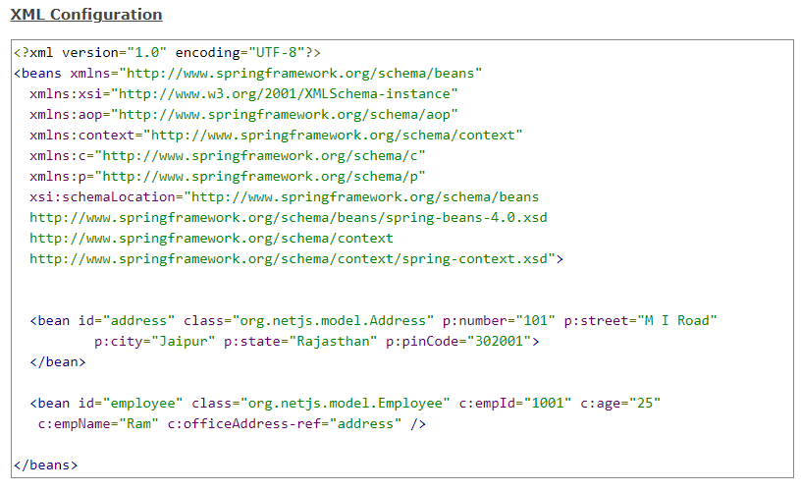
Using c- and p- namespaces in Spring

Slide 19
Bean Lifecycle
FactoryBean SpEL
Summary
Proxies
Profiles
BeanFactory Configuring Collections
Using c- and p- namespaces in Spring

